Slide 1
Electric Vehicle EDA with Feature Engineering

Slide 2



THE TEAM
Raju Sivaji Reddy Vineeth Paradesi Komal Tankashala
Team Lead Data Scientist Data Engineer

Slide 3
Contents
Problem Statement
Proposed solution
Data pipeline
Business understanding
Data Understanding
Data Preparation
Evaluation and Deployment
Conclusion
References

Slide 4
PROBLEM STATEMENT
As the world becomes increasingly conscious of the environmental impact of transportation, electric cars have emerged as a potential solution to reduce carbon emissions and promote sustainability.
However, the adoption of electric cars is still limited due to various factors, including high prices, limited range, and lack of charging infrastructure.
To promote the widespread adoption of electric cars, it is essential to understand the current state of the electric car market and identify potential areas for improvement.

Slide 5
PROPOSED PROBLEM SOLUTION
By analyzing the electric car dataset, we can identify potential areas for improvement and make recommendations for electric car advocacy groups to promote the adoption of electric cars.
We provide insights into the concentration of electric cars in urban areas and recommend that advocacy groups focus their efforts on promoting the use of electric cars in cities.

Slide 6
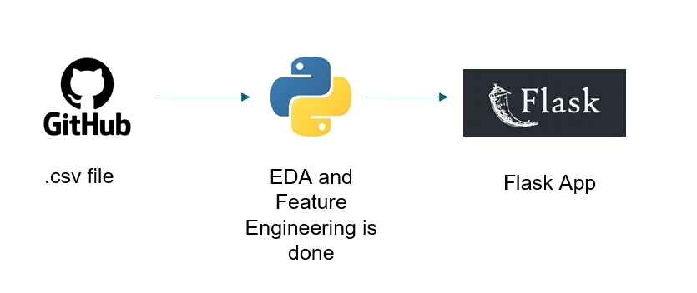
Data Pipeline

Slide 7
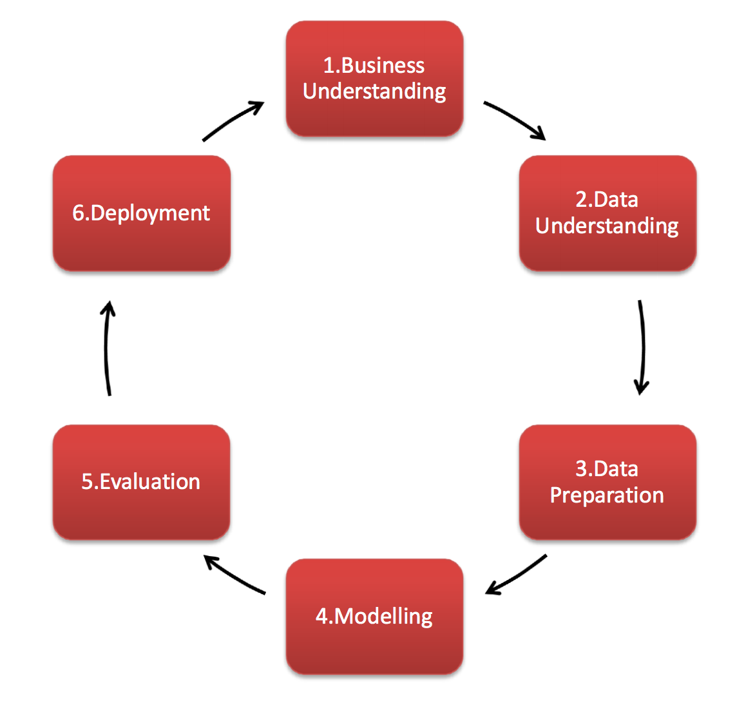
CRISP DM

Slide 8
BUSINESS UNDERSTANDING
As the Electric vehicles population is fast growing these years, there is a need to acknowledge that and make necessary preparations for the future.
This includes service stations, charging points, sale of automobile parts and customizations etc.,
Although the increase in population of electric vehicles is not the same in every state of the United States, we can prioritize making the above mentioned facilities in the states which have more electric vehicles accordingly.

Slide 9
DATA UNDERSTANDING
In this study, we analyze a dataset containing information about electric cars to gain insights into the electric car market.
The dataset is basically a survey which has 'gender,' 'state,' 'employment,' 'hsize,' 'housit,' 'residence,' 'bichoice,' 'buycar,' 'home_evse,' 'work_evse,' 'town,' 'highway,' 'home_parking,' 'work_parking,' 'RUCA,' 'Region,' 'Age_category,' 'education,' 'hsincome,' 'range.

Slide 10
DATA PREPARATION
Import Necessary Libraries
Data Pre processing
Feature Engineering
Exploratory Data Analysis

Slide 11
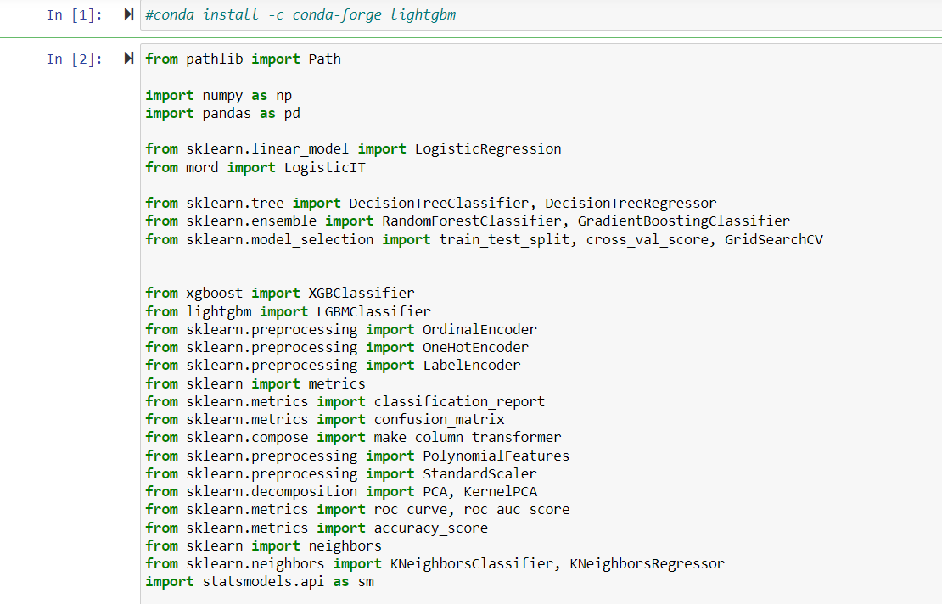
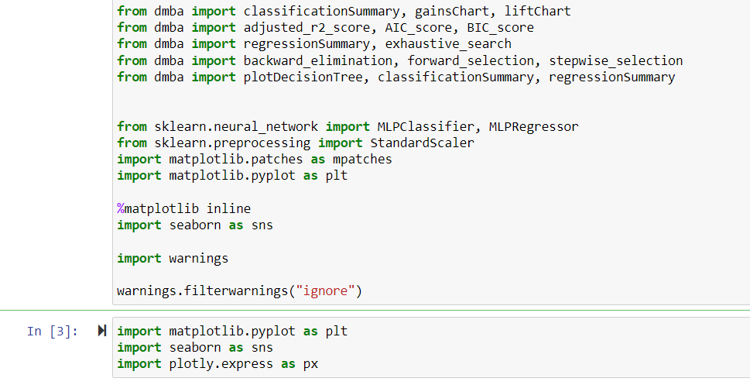
Import Necessary Libraries

Slide 12
Data Pre processing
Dataset Overview:
Dimensions: 5898 rows, 27 columns
No duplicate entries (duplicates: 0)
Missing Values:
No missing values observed in any column.
Data Types:
Majority of columns are of type 'int64.'
Two categorical columns: 'gender' and 'state.‘
Descriptive Statistics:
Descriptive statistics provided for all numerical columns.

Slide 13
Categorical Variable Transformation:
Categorical columns converted to 'category' type.
Columns converted: 'gender,' 'state,' 'employment,' 'hsize,' 'housit,' 'residence,' 'bichoice,' 'buycar,' 'home_evse,' 'work_evse,' 'town,' 'highway,' 'home_parking,' 'work_parking,' 'RUCA,' 'Region,' 'Age_category,' 'education,' 'hsincome,' 'range.‘
Ordinal Encoding:
'State' column encoded using ordinal encoding for numerical representation.
Final Dataset:
Dataset modified with updated data types.
Total columns: 27, Rows: 5898
Conclusion:
The dataset is well-prepared for further analysis with appropriate data types and encoding, ensuring compatibility for modeling and insights extraction.

Slide 14
Exploratory Data Analysis
Choropleth Map
EV Buying Intention
Gender-based EV Buying Intention
Bar Plots for Various Features
Correlation Heatmap
The visualizations provide valuable insights into the geographical distribution of EV interest, overall buying intentions, gender-based patterns, and correlations between various features in the dataset.

Slide 15
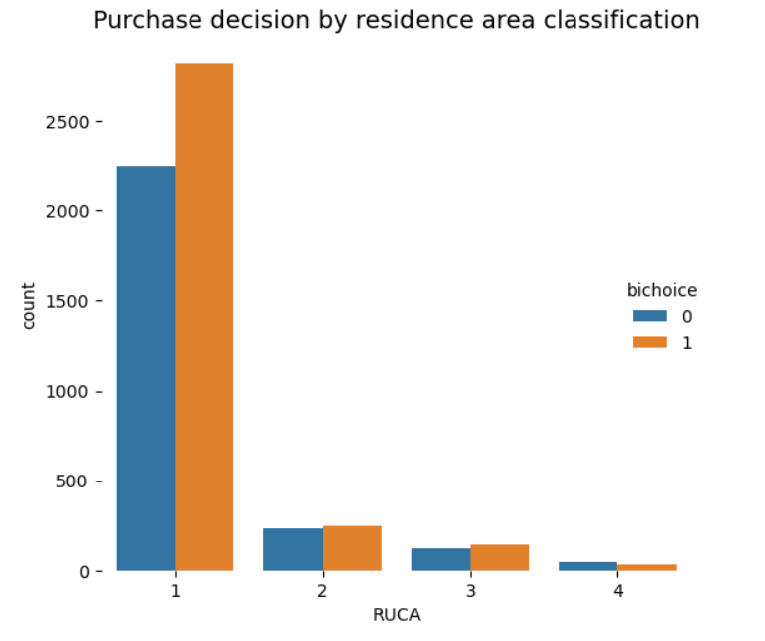
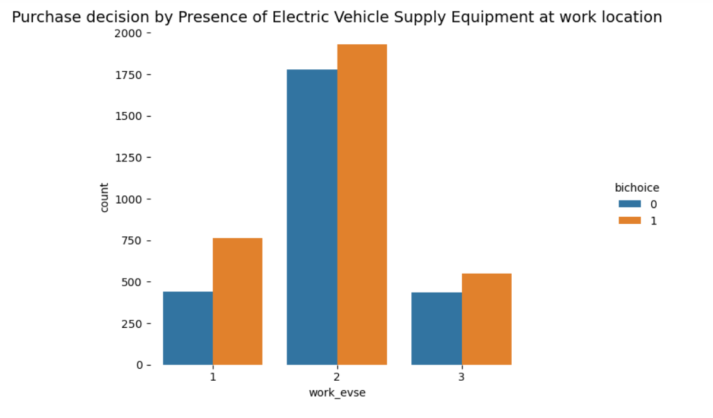
How does householders’ residence area classification (city/suburb/rural) influence their electric vehicle purchase decision?
Does having a charging point at work option influence a household’s decision to purchase EV?

Slide 16
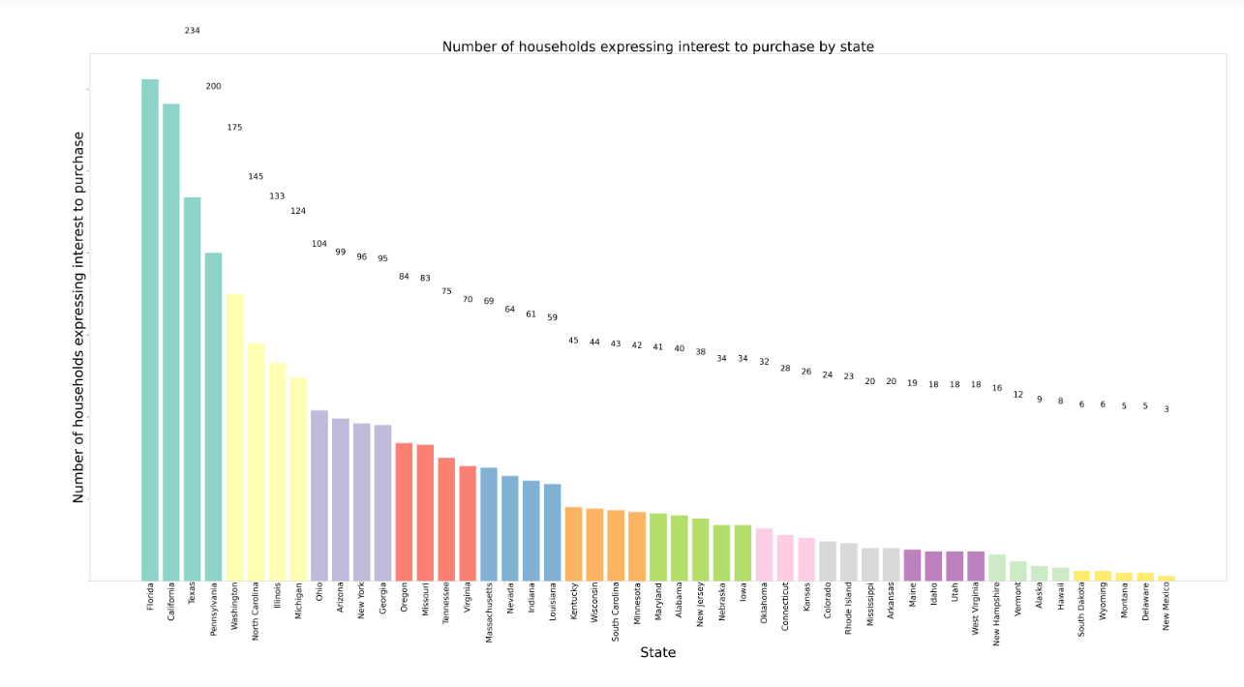
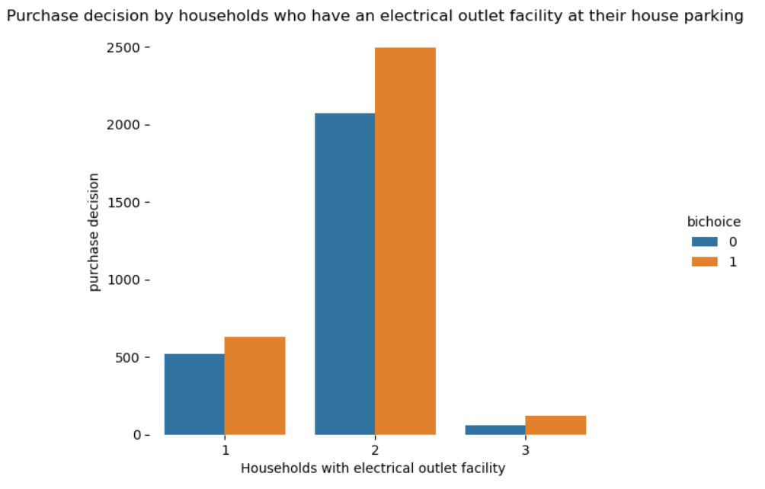
Do individuals who have an electric outlet facility at their home parking space show more interest to buy an electric vehicle?
Which states in the U.S. have the highest number of households expressing interest to purchase an electric car in the next three years?

Slide 17
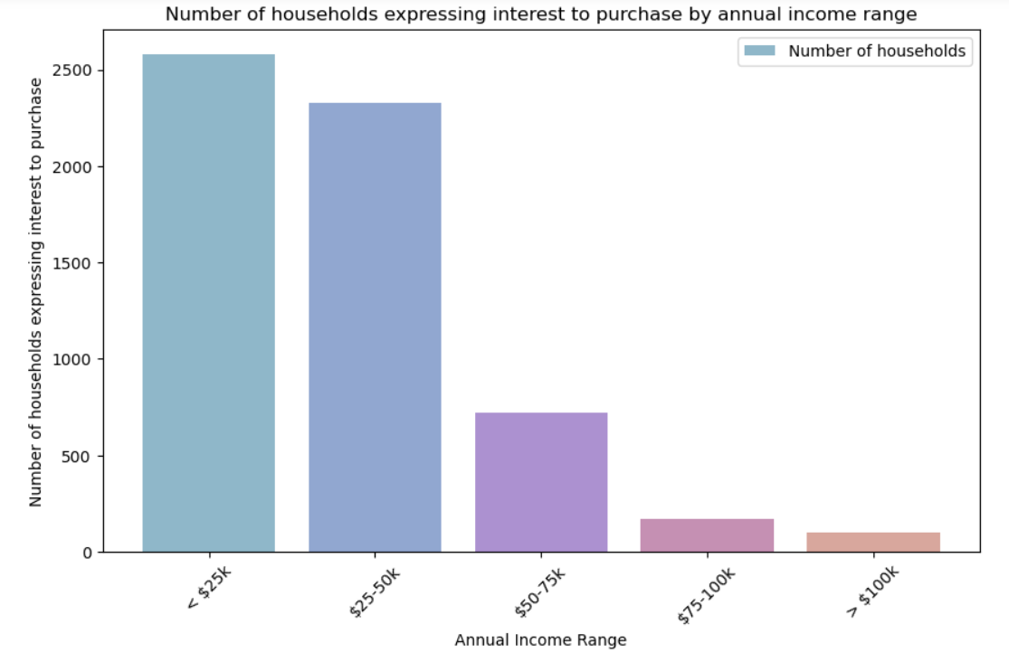
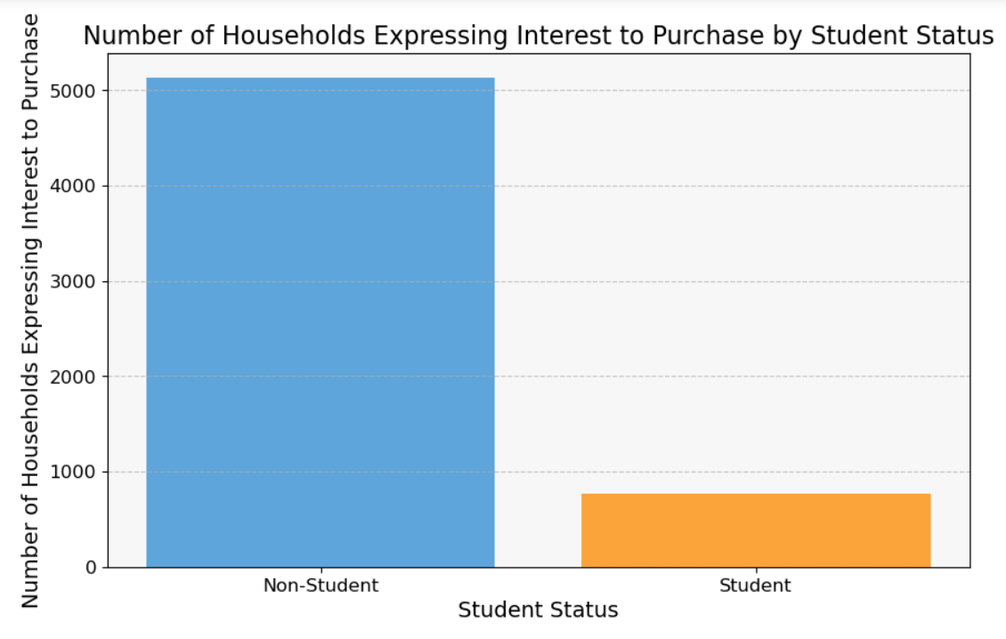
Does annual income impact a household’s choice of purchasing an electric vehicle?
Do students prefer to buy electric vehicles when compared to others?

Slide 18
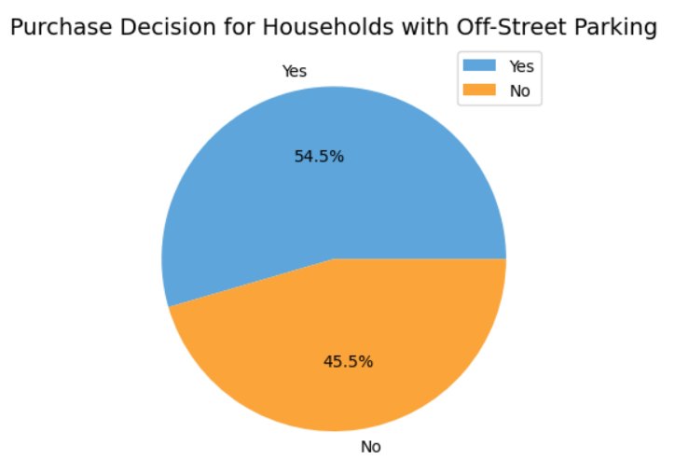
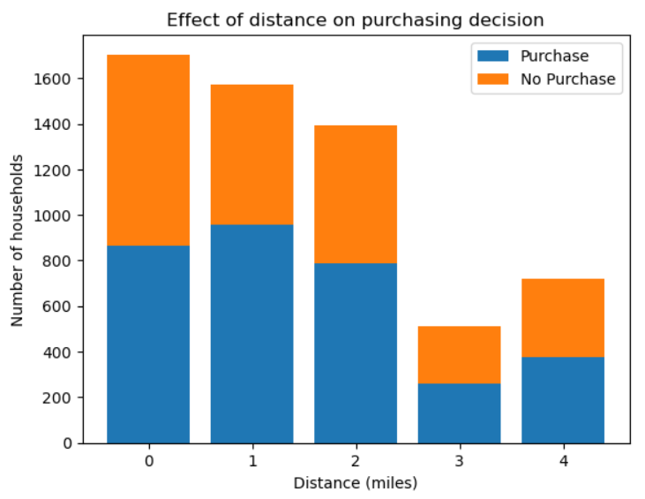
How does having an off-street/at home parking option influence a householder’s EV purchasing decision ?
How does the extent of long distance trips taken affect a householder’s decision to purchase an electric vehicle?

Slide 19
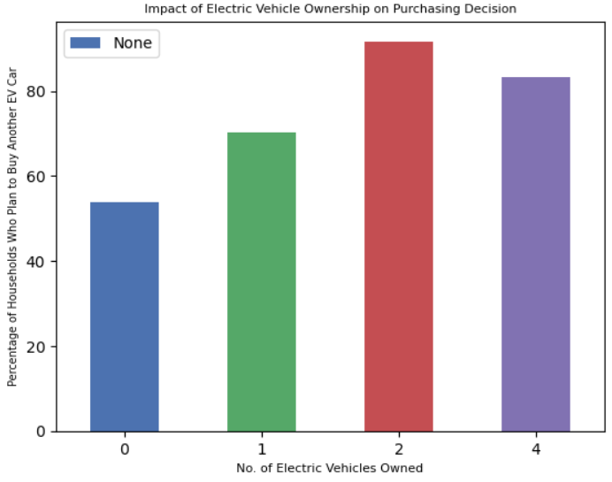
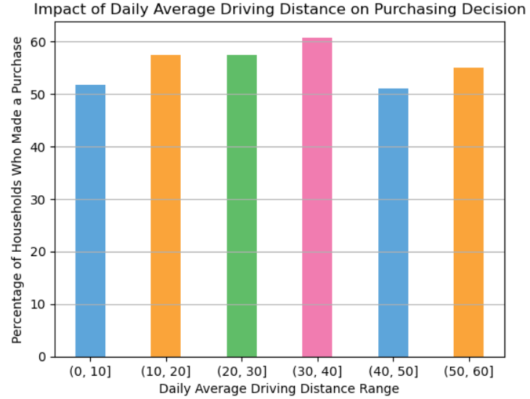
Does a household’s daily average driving distance impact their choice of buying an EV?
Does a household already owning an electric vehicle prefer to buy another EV?

Slide 20
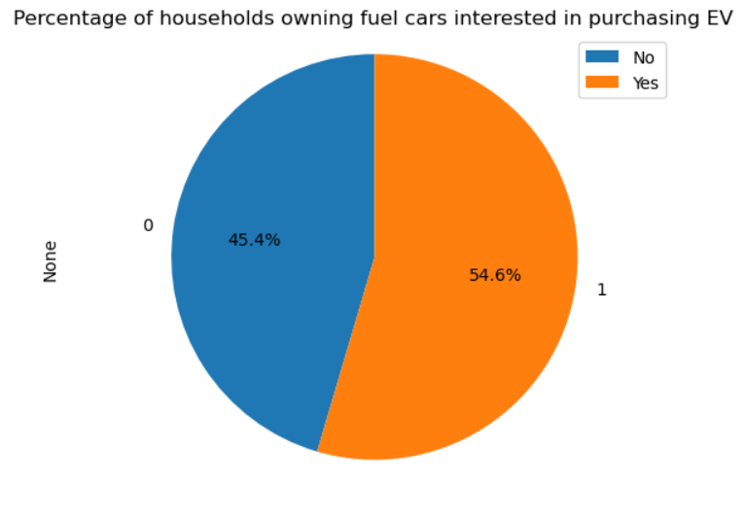
Do households currently owning a fuel vehicle show higher interest in purchasing an EV as a next car?

Slide 21
Feature Engineering
Creation of Combined Features:
Combined features were created by averaging 'home_parking' and 'home_evse' to form 'home_charging_facility.'
Similarly, 'work_parking' and 'work_evse' were averaged to create 'work_charging_facility.‘
Distribution Analysis:
The distribution of 'home_charging_facility' was visualized through a histogram, providing insights into the score frequency.
A similar distribution analysis was performed for 'work_charging_facility.‘
Comparison Plot:
A comparison plot was generated to visualize and compare the distributions of 'home_charging_facility' and 'work_charging_facility.'
The plot aids in understanding the relative frequencies and patterns of home and work charging facility scores.

Slide 22
Visualizations:
Individual distribution plots were created for 'home_charging_facility' and 'work_charging_facility.'
A combined comparison plot was generated to enhance the understanding of the charging facility scores at home and work.
Insights:
These visualizations offer a clear perspective on the distribution and relative frequencies of charging facility scores, facilitating further analysis and decision-making.
Next Steps:
Further analysis and modeling can leverage these engineered features to explore relationships and make predictions based on charging facility scores.

Slide 23
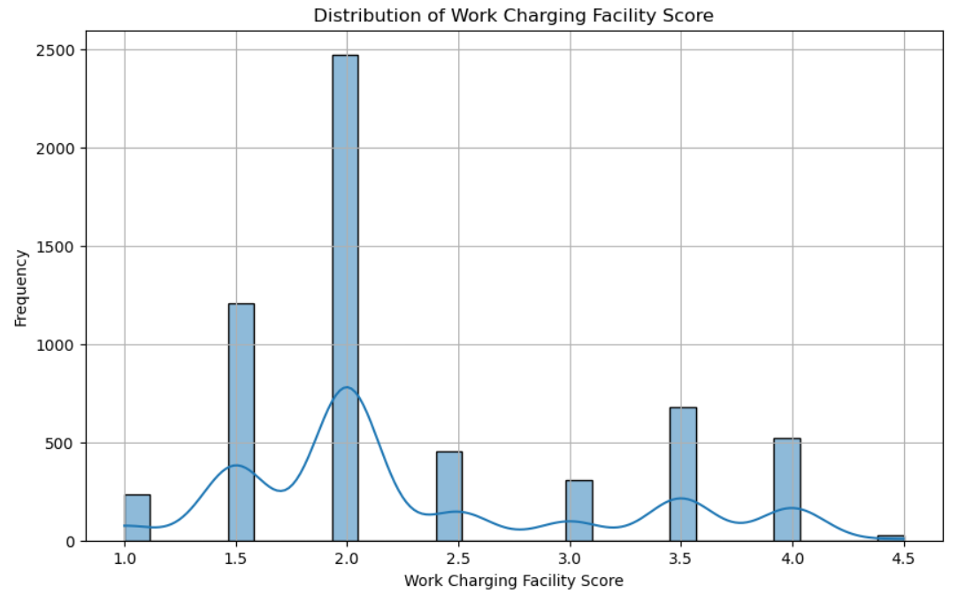
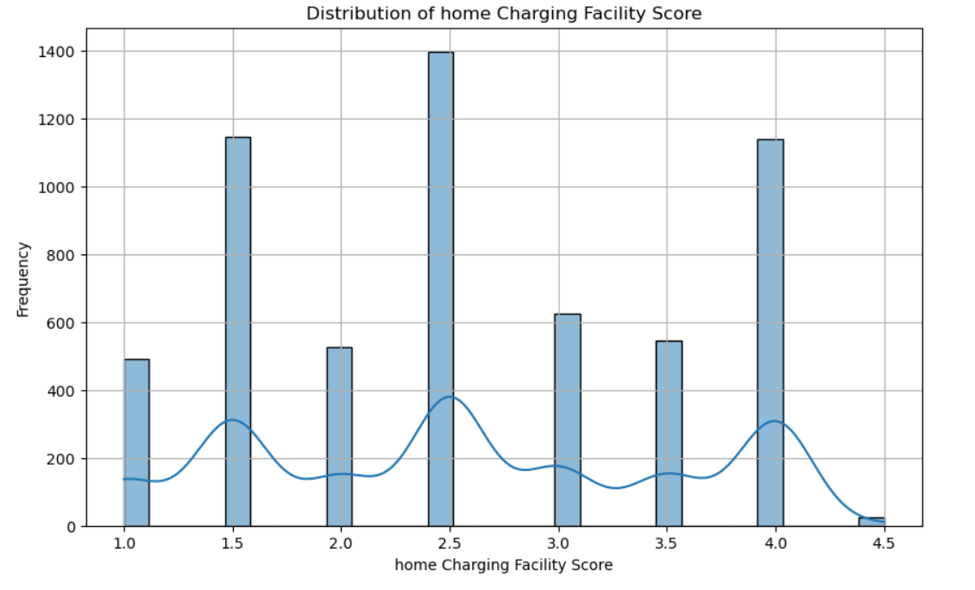
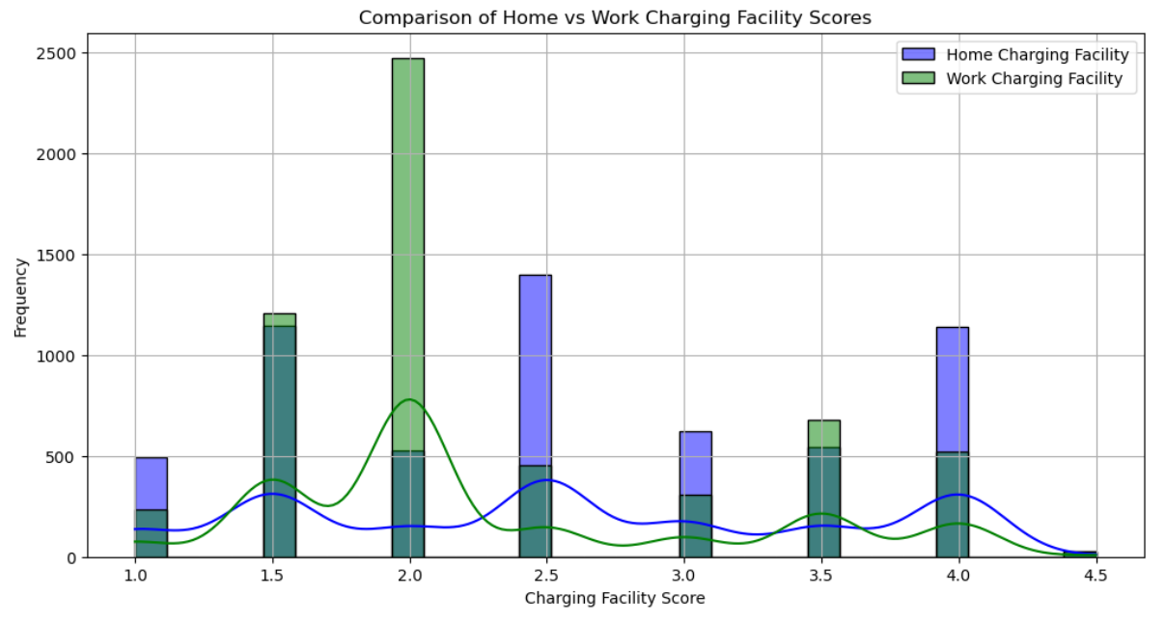

Slide 24
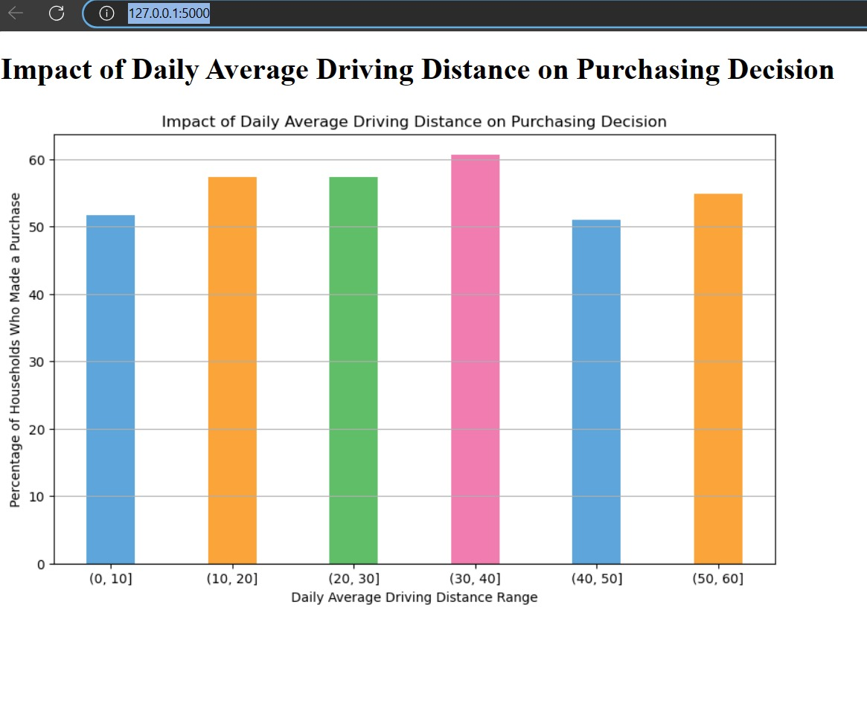
Evaluation and Deployment
We used a Flask application to deploy the results

Slide 25
Conclusion
In conclusion, by using EDA and Feature engineering, We found the necessary insights that are required for the electric car advocacies to focus businesses on the areas with high demand.
And we can derive the following from the feature engineering
The use of home charging facilities
The use of work charging facilities
And comparing which facilities people would use better
This provides an opportunity for the charging station companies to better understand the market and supply the equipment according to the demand.

Slide 26
References
Github - https://github.com/SivajiR45/DSCI6007_Team11

Slide 27
THANK YOU

